Slide 1
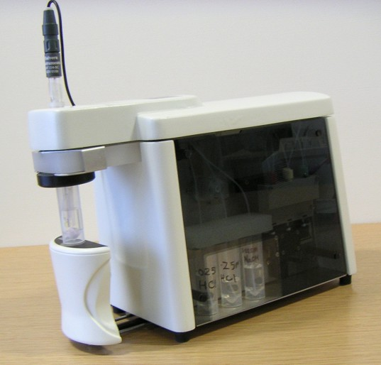
MPT2 - Multipurpose Titrator
Andrew Jones

Slide 2
Contents
MPT2 Overview
Titrator set up – pH calibration & titrator controls
Defining the analysis procedure
Viewing results
Applications

Slide 3
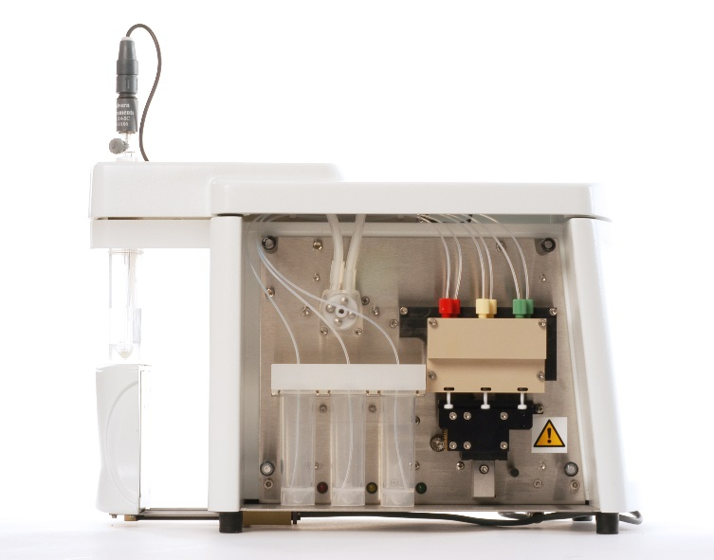
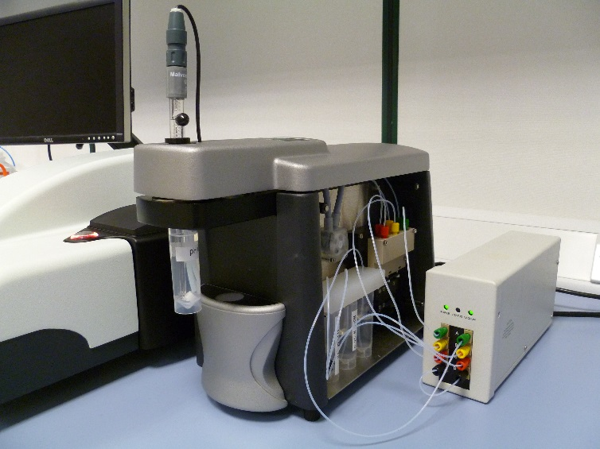
Zetasizer Nano with MPT2 auto titrator and in-line titrant degasser
The MPT2 in an integrated system designed to automate changes in the composition of the sample, then transfer the sample to the optics unit for measurement of the size, zeta potential and intensity
The following sample conditions can be programmed:
  pH
  Conductivity
  Additive concentration
  Sample concentration (dilution titration)

Slide 4
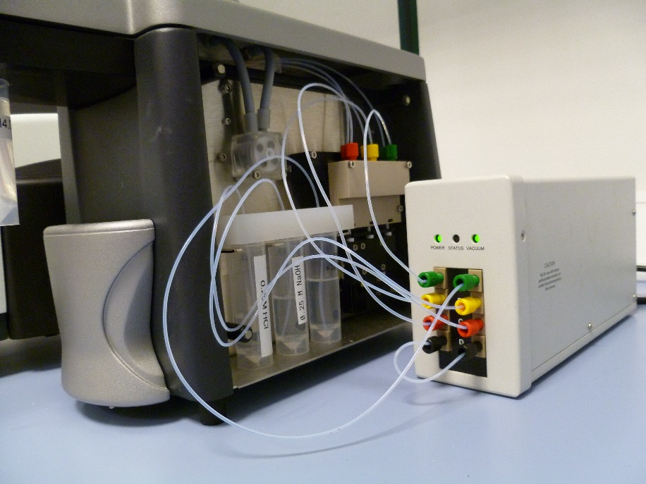
Set up of titrator with in-line degasser (DEG0003)
The degasser is supplied with fittings to connect it in line with each of the three titrant lines. Connection to the supplied external power supply provided completes set-up
On power-up the internal pump will create a vacuum and the orange status light will go off, leaving the green power and vacuum indicator lights illuminated

Slide 5
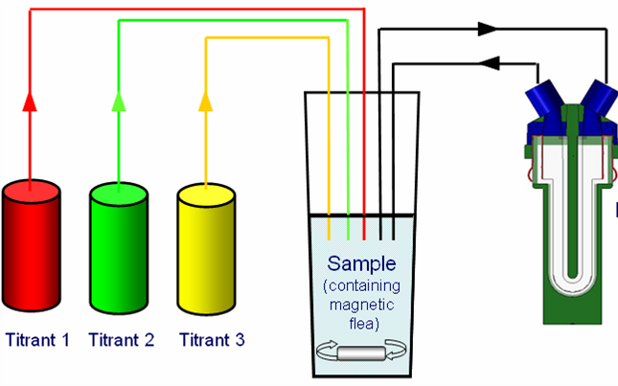
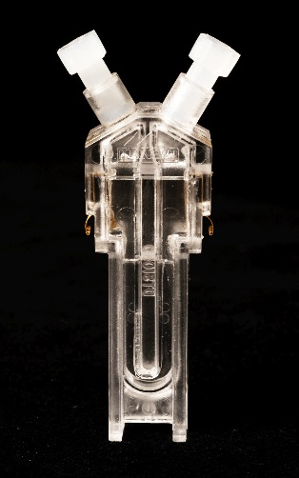
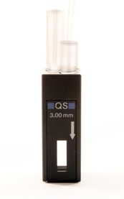
Typical titration schematic
Degasser
Can be used with:
Disposable zeta cell
Quartz flow cell

Slide 6
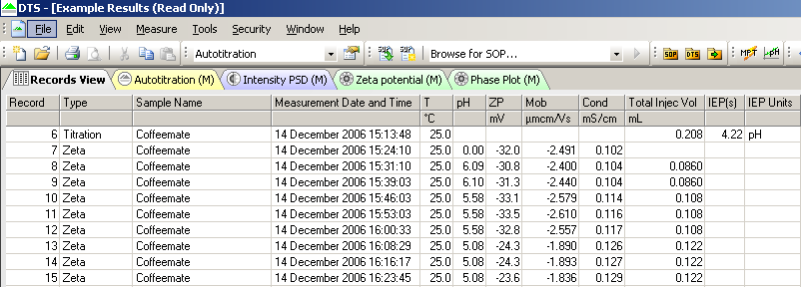
Auto titration procedure
Part One – Titrator set up
The Nano software contains 2 icons which control the MPT2 and are used to prepare the titrator ready for analysis
    Manual Control pH Calibration

Slide 7
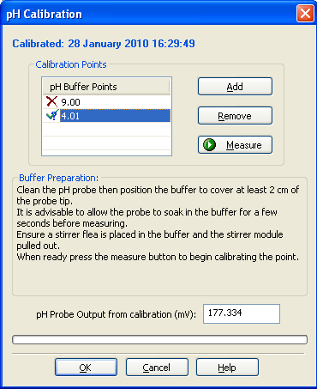
pH Calibration
This icon gives access to the pH calibration window from which the pH calibration points can be set and the calibration performed using suitable buffers

Slide 8
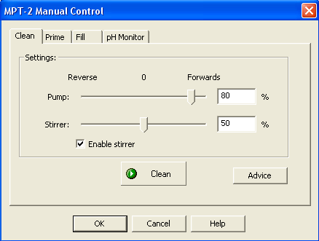
Manual Control
This is used to clean and prepare the unit prior to a measurement, and load the sample ready for analysis, using four commands:
Clean, Prime, Fill and pH Monitor

Slide 9
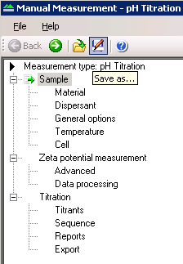
Auto titration procedure
Part Two - Defining the analysis procedure
Having calibrated the pH probe, cleaned the titrator, primed the titrants and loaded the sample to be analysed the next step is to set up the analysis routine within the software
The measurement routine can be set up and saved as an SOP for future analyses if required

Slide 10
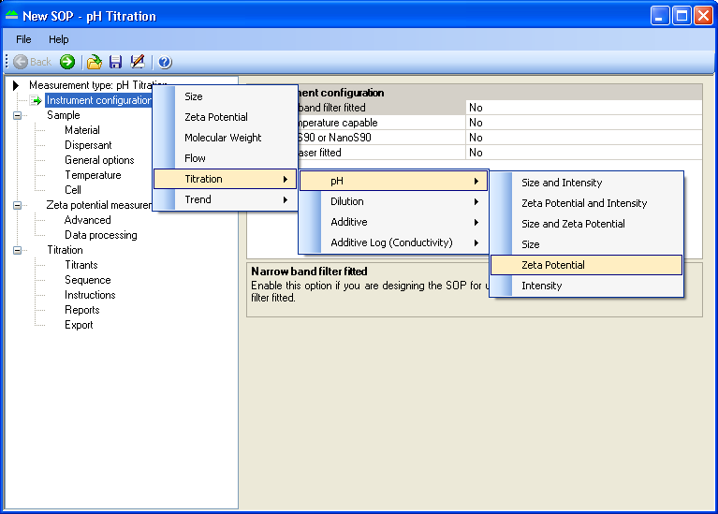
Defining the analysis procedure
Four different titrations available
  pH
  Dilution
  Additive
  Additive Log (Conductivity)
Parameters available will depend on instrument model
  Size
  Zeta potential
  Intensity
The measurement is set up by indexing through the “tree view” and editing the required analysis settings

Slide 11
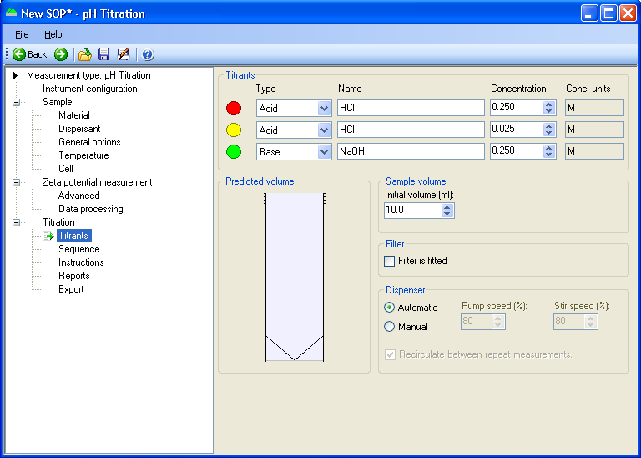
Defining the analysis procedure
Example pH titration
Enter titrant information
Depending on the direction of a pH titration, it is recommended to use 2 concentrations of either acid or base e.g.
  0.25M
  0.025M
This will ensure more accurate dosing around neutral pH
Enter initial sample volume

Slide 12
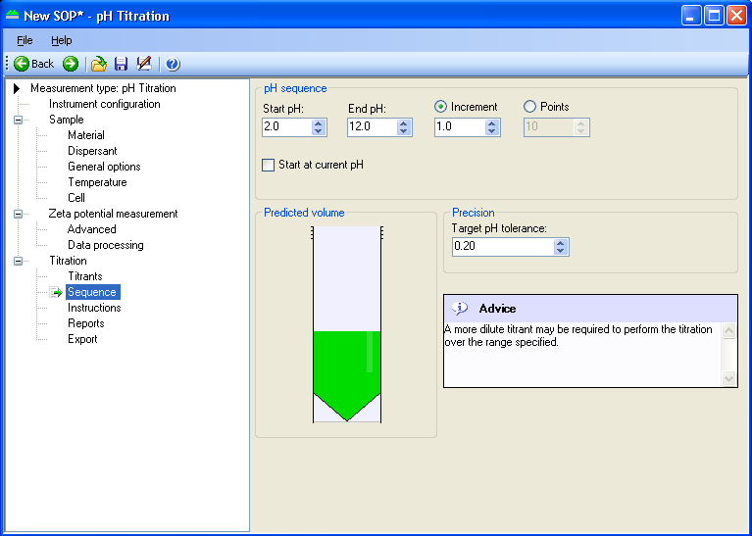
Defining the analysis procedure
Example pH titration
Setting titration sequence
Enter the start and end points for the titration and the number of analysis points
The precision box is only displayed for pH titrations
Advice is given to the user if inappropriate titrant concentrations are selected including a prediction of the final sample volume

Slide 13
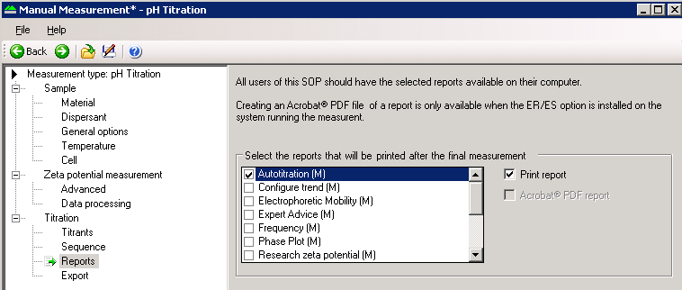
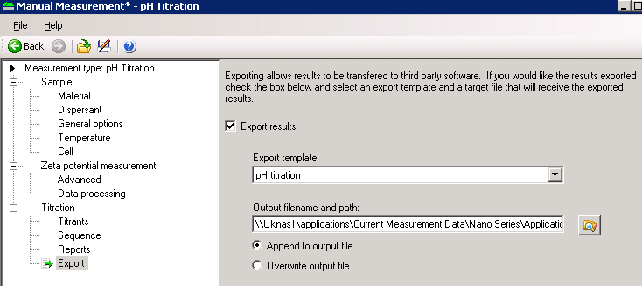
Defining the analysis procedure
Example pH titration
Set up auto report printing and auto data export if required

Slide 14
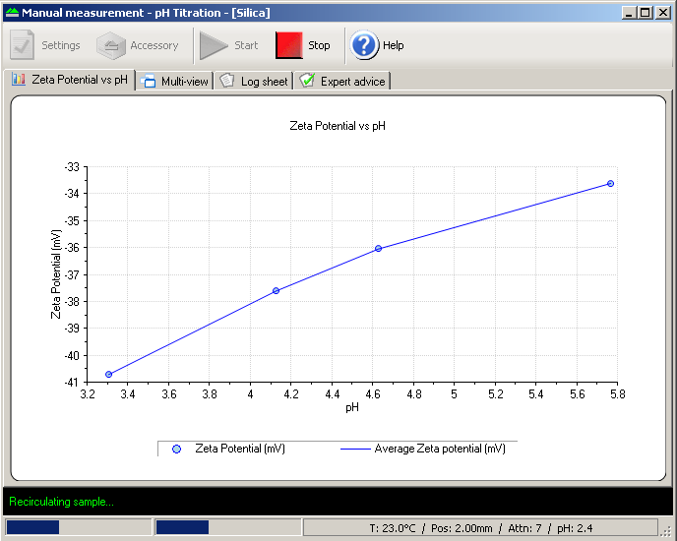
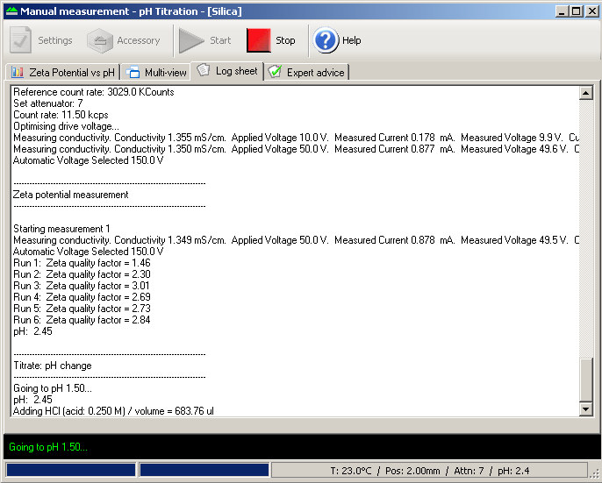
Viewing results during the measurement
The multi-tab live measurement window allows the progress of the titration to be monitored

Slide 15
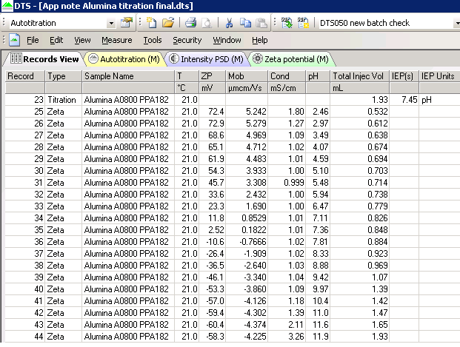
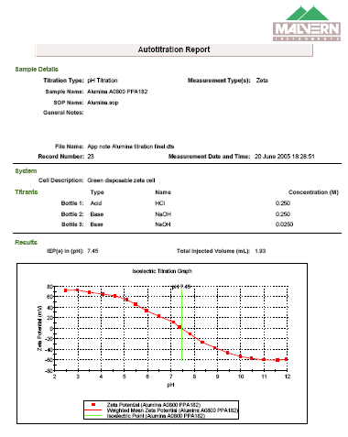
Viewing the results post measurement
The resultant titration record files will be displayed in the records view of the software and can be selected and viewed as an auto titration report
Data can easily be exported

Slide 16
Applications

Slide 17
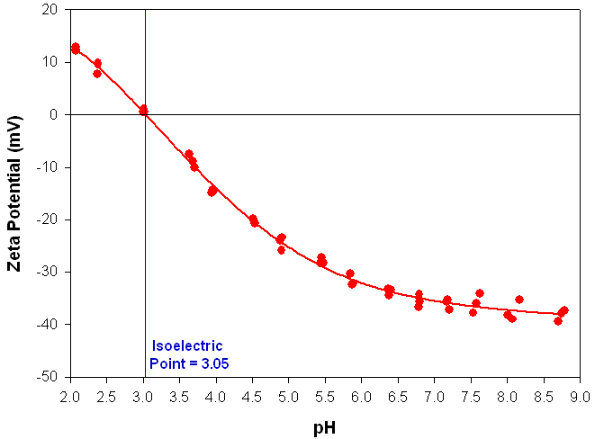
Isoelectric Point Determination: pH Titrations
Parameter | Value
Sample | TiO₂
Titrant 1 | 0.25M HCl
Titrant 2 | 0.025M NaOH
Titrant 3 | 0.25M NaOH
Start pH | 2
End pH | 9
pH Increment | 0.5
Number of measurements at each pH point | 3

Slide 18
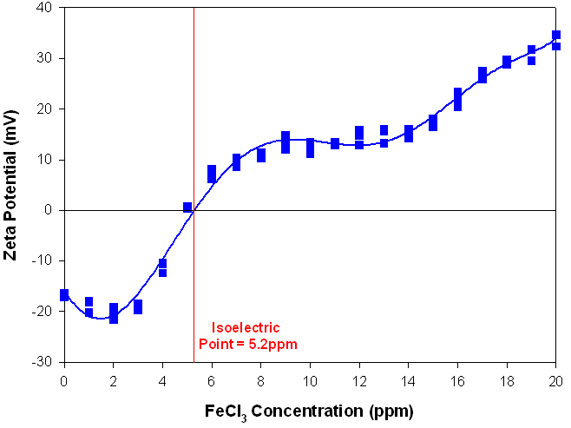
Isoelectric Point Determination: Linear Additive Titration
Parameter | Value
Sample | Mg(OH)₂
Titrant 1 | 1000ppm FeCl₃
Start Additive Concentration | 0ppm
End Additive Concentration | 20ppm
Additive Concentration Increment | 1ppm
Number of measurements at each pH point | 3

Slide 19
Ceramic Processing:
Effect of Binders and Dispersants
Polymers are used as binders and dispersants for improving ceramic processing
The binders impart strength to the formed products and help in the retention of shape
  Polyethylene glycol (PEG) is one of the important polymers used in ceramic processing as a binder and also as a plasticizer
The dispersants reduce the viscosity of the suspension, facilitating the dense packing of the particles in the product
  A commonly used dispersant is ammonium poly(methacrylate) (APMA)
Understanding the interaction between binders and dispersants in ceramic slurries can help determine the optimum conditions for a given ceramic suspension

Slide 20
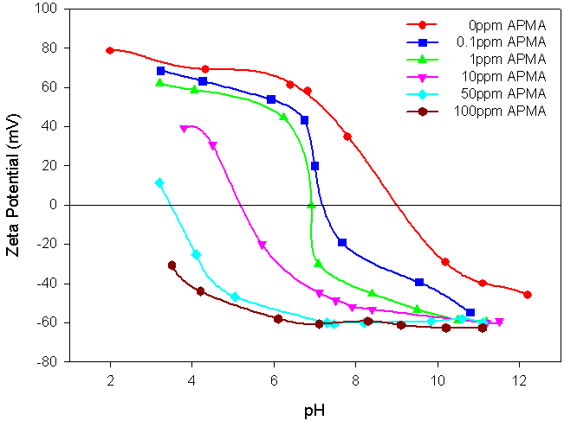
Ceramic Processing
Effect of APMA (dispersant) on Alumina
The isoelectric point (IEP) of alumina was found to be at pH 9.2 in the absence of any polymers
The zeta potential values of alumina are rendered more electronegative in proportion with the concentration of APMA added
The isoelectric point is also shifted to more acidic pH values, subsequent to the addition of APMA

Slide 21
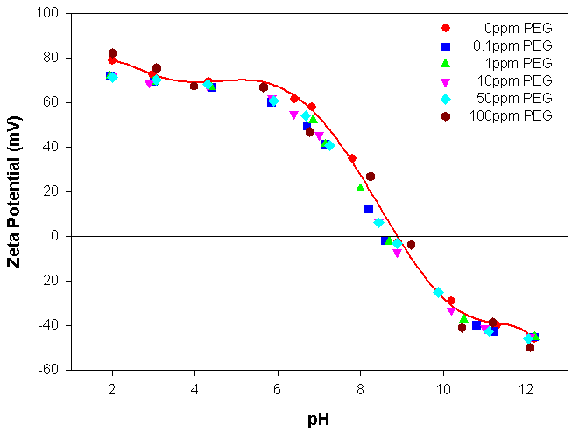
Ceramic Processing
Effect of PEG (binder) on Alumina
The addition of PEG only slightly alters the zeta potential values of alumina and there is negligible shift in the position of the IEP
The addition of PEG to the alumina suspension does not appreciably alter the electrokinetic behavior of the suspension
This can be attributed to the weak interaction of PEG with alumina

Slide 22
Analysis of Powders on Mastersizer:
Titanium dioxide in deionised water
Particle Size Distribution
12
10
8
Volume (%)
6
4
2
0
0.01
0.1
1
10
100
1000
Particle Size (µm)
09:42:34
09:43:34
09:44:35

Slide 23
Titanium Dioxide:
Additive Titration
-35
-40
-45
Zeta Potential (mV)
-50
-55
-60
-65
0
0.1
0.2
0.3
0.4
0.5
0.6
0.7
0.8
0.9
1
% w/v Calgon

Slide 24
Titanium Dioxide: pH Titration
-10
0.1% Calgon
-20
0.15% Calgon
-30
Zeta Potential (mV)
-40
-50
-60
-70
2
3
4
5
6
7
8
9
10
11
12
pH
pH

Slide 25
Titanium Dioxide:Mastersizer Analysis
0.15% Calgon, pH 11
14
Particle Size Distribution
12
10
8
Volume (%)
6
4
2
0
0.01
0.1
1
10
100
1000
Particle Size (µm)
14:24:22
14:24:37
14:25:03

Slide 26
Any Questions ?

